Slide 1
Decision Trees
By Reid Offringa PhD

Slide 2
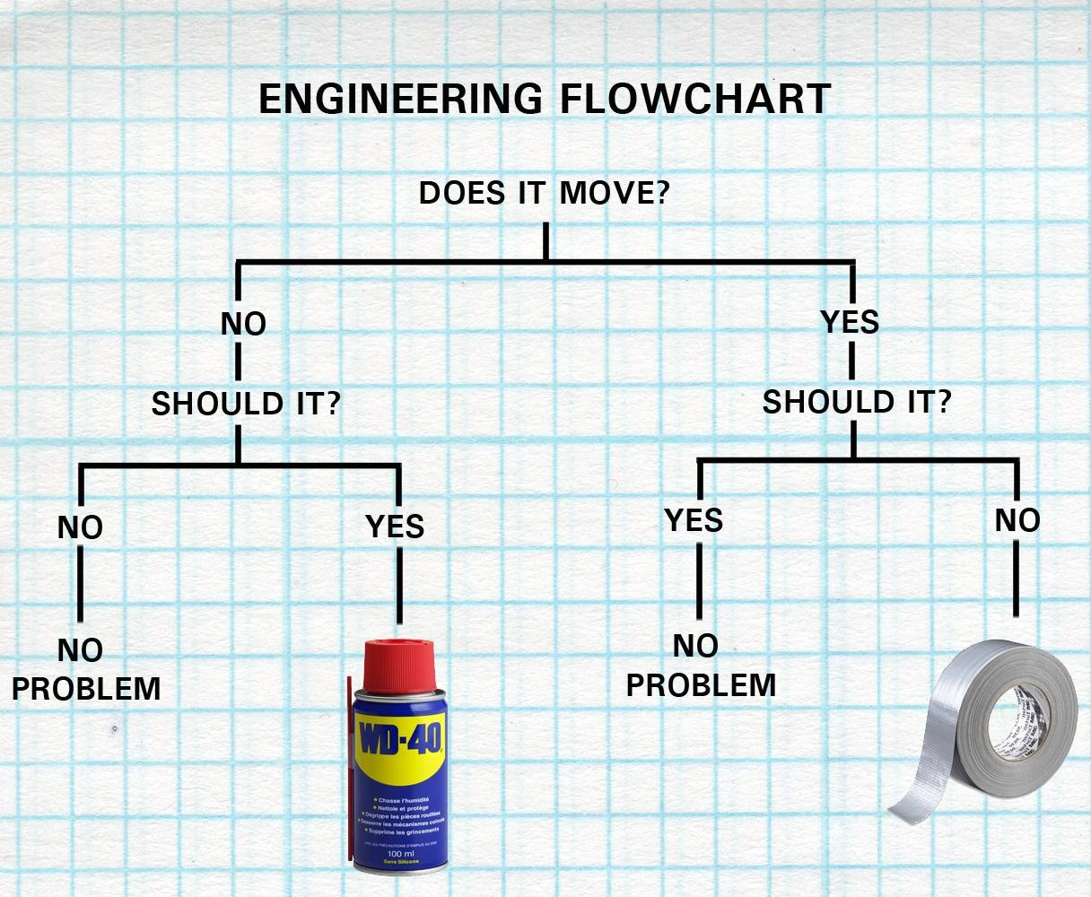
Motivation: Decision Trees
Intuitive machine learning process
Illustrates decision flow
Baseline for building and understanding more complicated algorithms

Slide 3
Objectives
Introduction to decision trees
Utilize new knowledge on a simple example
Successfully graph a simple example
Recognize limitations of decision trees

Slide 4
Should it move?
Item | DIM | SIM | mechanical | metal | Solution
door | no | yes | no | yes | WD40
chair | yes | no | no | yes | Duct tape
table | yes | no | no | yes | Duct tape
wheel | no | yes | yes | yes | WD40
cup | no | no | no | no | Duct tape
fan | no | yes | yes | yes | WD40
shoe | yes | no | no | no | Duct tape
lever | no | yes | yes | yes | WD40
cog | no | yes | yes | yes | WD40
painting | no | no | no | no | Duct tape

Slide 5
Simplest Decision Tree
Should it Move?
No
Yes
Item | Solution
chair | Duct tape
table | Duct tape
cup | Duct tape
shoe | Duct tape
painting | Duct tape
Item | Solution
door | WD40
wheel | WD40
fan | WD40
lever | WD40
cog | WD40

Slide 6
Already an Improvement!
Note: Our example only has two outcomes!
Should it Move?
No
Yes
Item | Solution
chair | Duct tape
table | Duct tape
cup | Duct tape
shoe | Duct tape
painting | Duct tape
Item | Solution
door | WD40
wheel | WD40
fan | WD40
lever | WD40
cog | WD40

Slide 7
More complicated Decision Tree (What if we didn’t know if it SHOULD move)
Does it Move?
Yes
No
Item | Solution
cup | Duct tape
painting | Duct tape
door | WD40
wheel | WD40
fan | WD40
lever | WD40
cog | WD40
Item | Solution
chair | Duct tape
table | Duct tape
shoe | Duct tape

Slide 8
More complicated Decision Tree
Does it Move?
Yes
No
Duct Tape
(3, 0)
WD40
(5, 2)

Slide 9
More complicated Decision Tree
Does it Move?
(5,5)
Yes
No
Duct Tape
(3, 0)
WD40
(5, 2)
Is it Metal?
No
Yes
Duct Tape
(2, 0)
WD40
(5, 0)

Slide 10
How do we make these decisions?
Does it Move?
(5,5)
Gini Impurity!
Yes
No
NOT PURE!
Pure!
Duct Tape
(3, 0)
WD40
(5, 2)
More Pure Than above
Is it Metal?
No
Yes
Pure!
Duct Tape
(2, 0)
WD40
(5, 0)
Pure!

Slide 11
New Data Point! Suit of Armor
Does it Move?
(5,5)
Armor
Yes
No
Duct Tape
(3, 0)
WD40
(5, 2)
Is it Metal?
No
Yes
Duct Tape
(2, 0)
WD40
(5, 0)

Slide 12
Advantages
Limitations
Simple
Easy to illustrate
Building block to more complicated classifiers
E.g. Random forests
Not very versatile
Low reliability
Prone to overfitting
Prone to random error
E.g. Order of variables chosen can influence final results
How can we fix this?

Slide 13
How can we fix this? A Preview of next class!
Randomly sample observations
Randomly sample features
Run a LOT of decision trees
Average together responses
Random Forests!

Slide 14
In Class Exercise
Run a decision tree for sample data set
Using scikit learn
Sample dataset
Iris dataset
What is the outcome for..
Sepal Length: 1
Sepal Width: 2
Petal Length: 1
Petal Width: 0.7

